Slide 1

KINECT SENSOR BASED ABNORMAL MOVEMENTS OF ELDERLY PATIENT MONITORING SYSTEM
DEPARTMENT OF ELECTRONICS AND COMMUNICATION ENGINEERING
TEAM MEMBERS:
SASIDHARAN A – 611221106093
JANAKAN S – 611221106047
JANARTHANAN S – 611221106049
ARISHKUMAR N – 611221106009
PROJECT SUPERVISOR : Mrs. CHITRAPPAAVAI L (AP/ECE)

Slide 2
OUTLINE OF THE PRESENTATION
Introduction
Objective of the Project
Abstract
Literature Review
Existing System
Problem Identified
Proposed System
Methodology
System Requirements
Results & Discussion
Conclusion & Future Work
References

Slide 3
INTRODUCTION
Elderly individuals are at high risk of injury from accidental falls and unsupervised wandering, particularly those with cognitive impairments. Traditional monitoring systems, such as wearable sensors and surveillance cameras, often suffer from drawbacks like intrusiveness, poor compliance, and limited coverage. To address these issues, a non-invasive real-time monitoring system is proposed using the Microsoft Kinect depth sensor.

Slide 4
OBJECTIVE
The primary goal of this project is to design and implement a real-time monitoring system for elderly individuals using Microsoft Kinect. The system aims to detect abnormal movement events such as falls or movement outside predefined safe zones without requiring the patient to wear any sensors or devices. Upon detecting such events, the system sends immediate alerts to caregivers through a mobile notification platform (Telegram), allowing for prompt action. The system is designed to be low-cost, non-intrusive, and scalable, making it suitable for deployment in homes, hospitals, and assisted living facilities.

Slide 5
ABSTRACT
This project demonstrates the integration of Microsoft Kinect sensor technology with real-time alert mechanisms for elderly safety monitoring. The system utilizes 3D skeletal tracking to continuously monitor the posture and movements of an individual. Detection algorithms analyze skeletal joint data to recognize patterns indicating a fall or boundary violation. When such an event is confirmed, an alert containing the user ID and timestamp is sent via a server to a caregiver’s mobile device through the Telegram application. The key strengths of the system lie in its contactless design, fast response time, and reliable detection capability. By eliminating the need for wearables and manual surveillance, this system ensures improved comfort and privacy for the elderly while enhancing the caregiver’s ability to respond quickly to emergencies.
Keywords: Kinect Sensor, Fall Detection, Skeletal Tracking, Elderly Monitoring, Real-Time Alert, Telegram Notification

Slide 6
LITERATURE REVIEW
S.No. | Author Name, Paper Title, Journal Name, Year | Technique Used | Merits | Demerits
1 | B. Li et al., Fall Detection Using Depth Camera and Posture Estimation, IEEE Access, 2020 | Skeleton tracking with depth camera | High accuracy in detecting falls using joint analysis | Sensitive to occlusion and environmental lighting
2 | S. Khan et al., Vision-Based Elderly Monitoring Using Skeletal Tracking, Int. J. of Computer Applications, 2019 | Kinect-based 3D skeletal tracking | Non-contact and continuous monitoring | Limited to indoor environments with stable lighting

Slide 7
S.No. | Author Name, Paper Title, Journal Name, Year | Technique Used | Merits | Demerits
3 | G. Mastorakis and D. Makris, Fall Detection System Using Kinect’s Infrared Sensor, Sensors, 2014 | Infrared depth sensing and posture analysis | Real-time detection without wearables | Affected by furniture and clutter in the room
4 | J. Wang et al., Fall Detection Using Skeletal Data and SVM Classifier, Expert Systems with Applications, 2020 | Machine learning using SVM with skeletal data | High precision classification | Requires a large and diverse training dataset
5 | R. Planinc and M. Kampel, Introducing the Use of Depth Data for Fall Detection, Ambient Intelligence and Smart Environments, 2013 | Depth image analysis | Works in low-light environments | Requires high-quality depth data.

Slide 8
S.No. | Author Name, Paper Title, Journal Name, Year | Technique Used | Merits | Demerits
6 | F. Merrouche and N. Baha, Fall Detection Using Head Tracking and Centroid Movement, Procedia Computer Science, 2017 | Head centroid trajectory detection using depth cameras | Detects sudden head movement falls effectively | May not detect soft or slow falls.
7 | V. Bevilacqua et al., Fall Detection in Indoor Environment with Kinect Sensor, Procedia Computer Science, 2014 | Posture analysis using Kinect | Efficient for indoor use | Not scalable for outdoor or dynamic lighting scenarios
8 | M. Kepski and B. Kwolek, Human Fall Detection by Mean Shift Combined with Depth Connected Components, Multimedia Tools and Applications, 2012 | Mean shift and depth segmentation | Accurate figure tracking | Requires computational resources and preprocessing

Slide 9
S.No. | Author Name, Paper Title, Journal Name, Year | Technique Used | Merits | Demerits
9 | C. Rougier et al., Fall Detection Using Depth Map Video Sequences, Pattern Recognition Letters, 2011 | Depth video pattern recognition | Preserves privacy without RGB data | Performance affected by multiple subjects
10 | Ayman Al-Kababji et al., An IoT-Based Framework for Remote Fall Monitoring, Sensors, 2021 | IoT framework with cloud communication | Real-time alerts to caregivers | Relies on user to wear and maintain device
11 | Ekram Alam et al., Real-Time Fall Detection Using Lightweight Pose Estimation, Applied Sciences, 2024 | Pose estimation via Movement | Runs on low-power devices in real time | Sensitive to crowded or obstructed scenes.

Slide 10
EXISTING SYSTEM
Current systems employed for elderly monitoring largely depend on wearable devices like smart bands, panic buttons, or accelerometers, which must be consistently worn by the user. These solutions often become ineffective if the user forgets to wear the device or finds it uncomfortable. Video surveillance systems require constant monitoring, are expensive to maintain, and can infringe on privacy. Additionally, both types of systems often suffer from poor real-time response and may not effectively distinguish between normal and abnormal activities, leading to frequent false alarms or missed events.

Slide 11
PROBLEM IDENTIFIED
User Discomfort: Wearable devices can be intrusive or uncomfortable, especially for long-term use.
Dependency on User Compliance: Individuals with cognitive impairments may forget or refuse to wear monitoring devices.
Privacy Violations: Continuous camera-based surveillance can infringe on personal privacy.
Delayed Alert Mechanisms: Many systems do not provide real-time notifications, leading to delayed response.
Limited Coverage Areas: Some solutions only monitor specific zones, reducing effectiveness in larger environments.
Need for Human Monitoring: Surveillance-based systems often require manual observation, limiting automation and scalability.

Slide 12
PROPOSED SYSTEM
Real-Time Data Capture: The system uses the Microsoft Kinect sensor to capture depth and skeletal data of individuals in real-time.
3D Skeletal Modeling: Kinect tracks 20 body joints and generates a 3D skeletal model of the user.
Fall and Movement Detection: Detection algorithms analyze skeletal movements to identify unusual changes such as sudden drops in head or torso height, lying postures, or absence from the sensor’s field of view.
Virtual Boundary Monitoring: The system defines virtual zones, and an "out-of-coverage" alert is triggered if the user moves beyond these boundaries.
Alert Transmission: Alerts are sent to a central server and forwarded to a caregiver’s mobile phone via the Telegram messaging app.
Efficient Communication Flow: This layered system ensures seamless and timely communication from sensor to caregiver, with high detection accuracy and minimal delay.

Slide 13
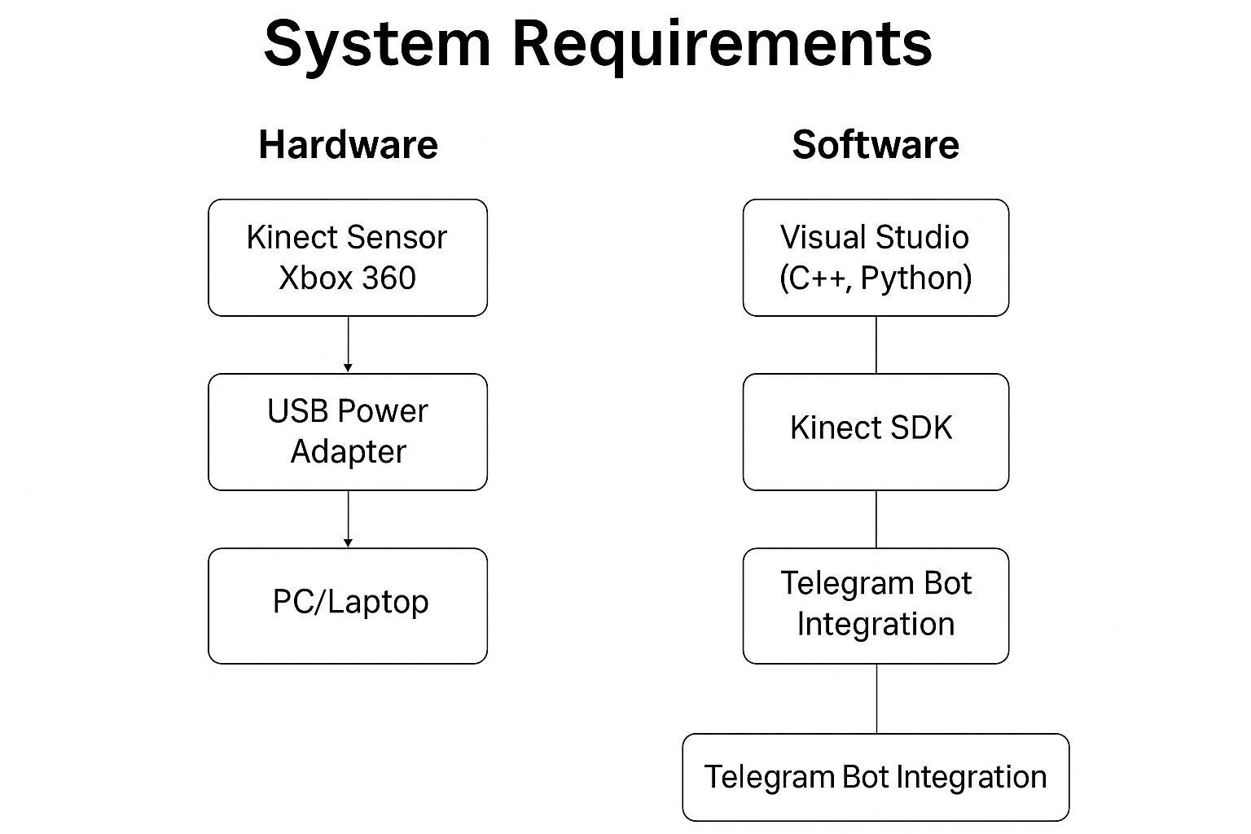
SYSTEM REQUIREMENTS

Slide 14
METHODOLOGY
1. Sensing Layer (Data Acquisition)
Device: Microsoft Kinect Xbox 360
Captures 3D skeletal, depth, and RGB data
Tracks 20 joints in real time (e.g., head, spine, limbs)
High frame rate (30 FPS) ensures smooth motion tracking
2. Processing Layer (Detection Algorithms)
Software: Visual Studio (C++/Python), Kinect SDK
Fall Detection:
Sudden height drop (e.g., head, spine)
Orientation change (vertical to horizontal)
Posture analysis (lying flat)
3. Notification Layer (Real-Time Alerts)
Events sent to server via Wi-Fi
Alert via Telegram bot to caregiver’s mobile
Message includes user ID, event type, timestamp

Slide 15
RESULTS & DISCUSSION
The system was evaluated under different test scenarios including simulated falls, normal movements, and intentional exits from the coverage area. It showed high accuracy in distinguishing between normal and abnormal activities. The average response time between event detection and alert delivery was under five seconds. The skeletal tracking approach significantly reduced false positives compared to traditional motion sensors. The use of Telegram as the alert platform ensured easy accessibility and immediate visibility for caregivers. The system was well-received in test environments for its simplicity, responsiveness, and non-intrusiveness.

Slide 16
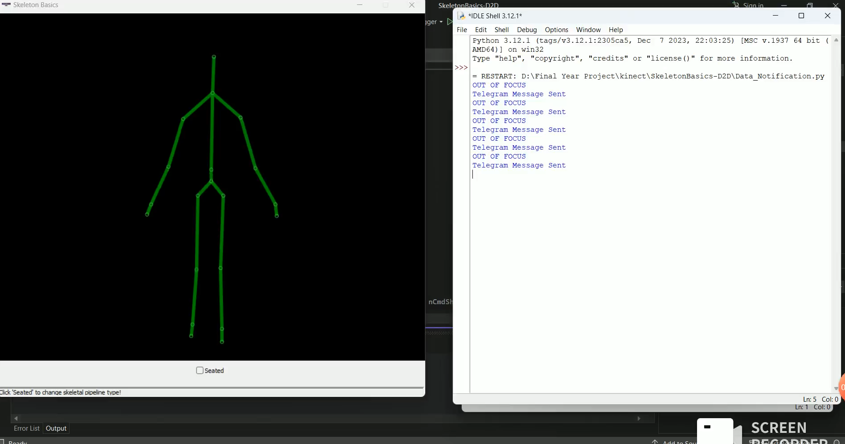
Simulation Output

Slide 17
CONCLUSION & FUTURE WORK
This Kinect-based monitoring system presents a practical and innovative approach to elderly care. It successfully overcomes the limitations of existing solutions by offering a non-contact, real-time, and automated detection system. Its ability to provide immediate alerts to caregivers helps in minimizing the risks associated with falls and wandering, thereby promoting independent living for elderly individuals. For future enhancements, the system can incorporate machine learning to improve event classification and reduce false alarms further. Integration with other IoT-based health sensors and support for video logging or emergency services notification are also potential areas of development.

Slide 18
REFERENCES
Y. Takahashi, M. Takagi and K. Inoue, "Development of a Communication Robot System for Monitoring Older People," IECON 2019 - 45th Annual Conference of the IEEE Industrial Electronics Society, Lisbon, Portugal, 2019, pp. 6866-6870, doi: 10.1109/IECON.2019.8927408.
K. Ogawa, "A Smart LED Cane to Monitor Older People Living Alone for Considering Privacy," 2022 IEEE 11th Global Conference on Consumer Electronics (GCCE), Osaka, Japan, 2022, pp. 232-234, doi: 10.1109/GCCE56475.2022.10014367.
D. Prabhu et al., "Detecting Depression-related Movement Changes in Older Adults using Smart Home Motion Sensors - A Feasibility Study," 2023 45th Annual International Conference of the IEEE Engineering in Medicine & Biology Society (EMBC), Sydney, Australia, 2023, pp. 1-5, doi: 10.1109/EMBC40787.2023.10340431.
S. Deepika and K. P. Vijayakumar, "IoT based Elderly Monitoring System," 2022 6th International Conference on Trends in Electronics and Informatics (ICOEI), Tirunelveli, India, 2022, pp. 573-579, doi: 10.1109/ICOEI53556.2022.9777186.

Slide 19
X. Gu and X. Chang, "Long-term Effects of Wearable Health Technology and Future MHealth Usage for Older Adults," 2024 IEEE International Conference on Industrial Engineering and Engineering Management (IEEM), Bangkok, Thailand, 2024, pp. 618-622, doi: 10.1109/IEEM62345.2024.10857169.
T. I. Ursache, R. Pogoreanu, R. G. Bozomitu, and C. Rotariu, “Web Based Medical System for Remote Heart Rate Monitoring with Cloud Integration,” in 2022 E-Health and Bioengineering Conference (EHB), 2022, pp. 1–4. doi: 10.1109/EHB55594.2022.9991470.
G. M. Balbim et al., “Using Fitbit as an mHealth Intervention Tool to Promote Physical Activity: Potential Challenges and Solutions,” JMIR Mhealth Uhealth, vol. 9, no. 3, p. e25289, Mar. 2021, doi: 10.2196/25289.
M. Patra, B. Sahoo, and A. Turuk, “Containerization in cloud computing for OS-level virtualization,” 2022, pp. 261–276. doi: 10.1201/9781003269144- 16.
D. Mu, M. Sha, K.-D. Kang, and H. Yi, “Energy-Efficient Radio Selection and Data Partitioning for Real-Time Data Transfer,” in 2019 15th International Conference on Distributed Computing in Sensor Systems (DCOSS), 2019, pp. 49–57. doi: 10.1109/DCOSS.2019.00030.
B. Soewito, Christian, F. Gunawan, D. Diana, and I. Kusuma, “Websocket to Support Real Time Smart Home Applications,” Procedia Computer Science, vol. 157, pp. 560–566, Jan. 2019, doi: 10.1016/j.procs.2019.09.014.

Slide 20
THANK YOU!..

